Slide 1


Slide 2
Team members
Ahmed Abd-Ellatif Mhana
Ahmed Magdy Zaki
Ahmed Alaa-Eldin Abd-Elwahab
Mohamed Nabil Mansour
Supervisors
Dr. Ahmed Mahmoud Gawish
Dr. Taha Zaki

Slide 3


Slide 4
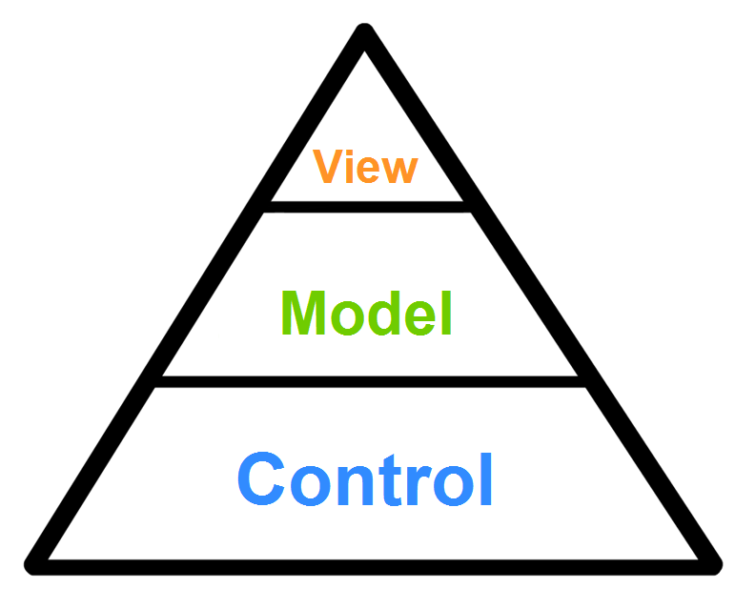
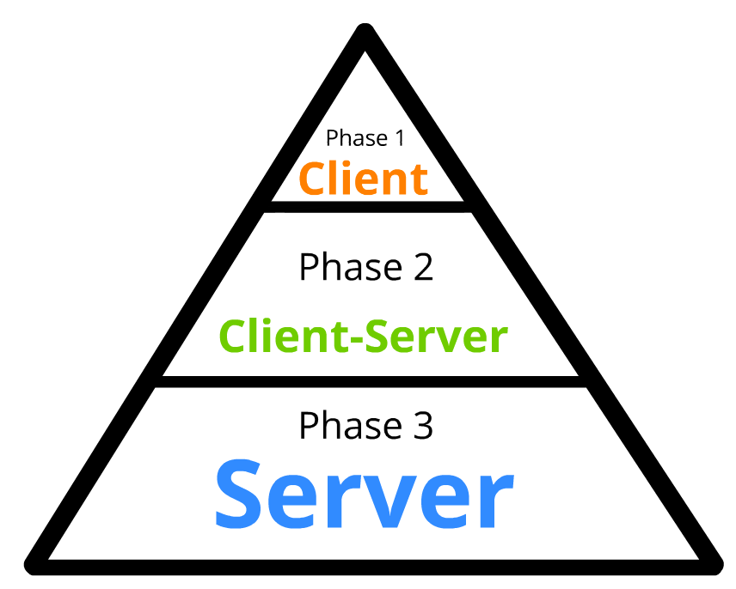

Slide 5
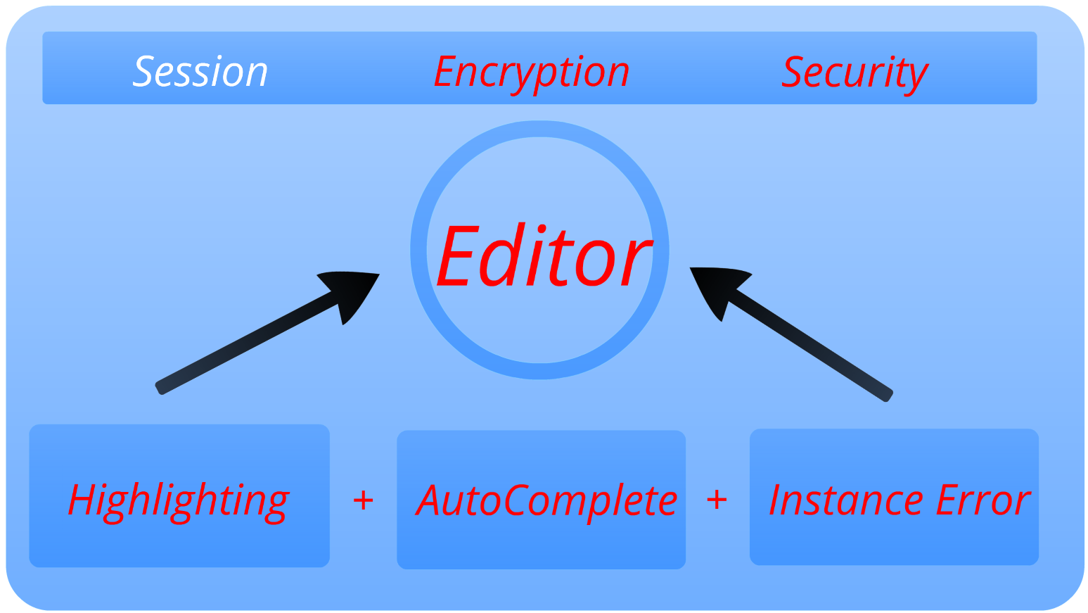
View

Slide 6
Model

Slide 7
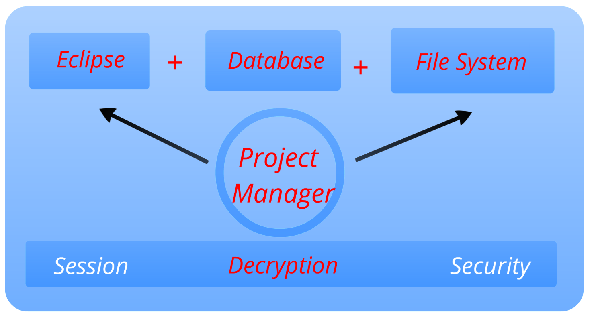
Control

Slide 8
Demo

Slide 9

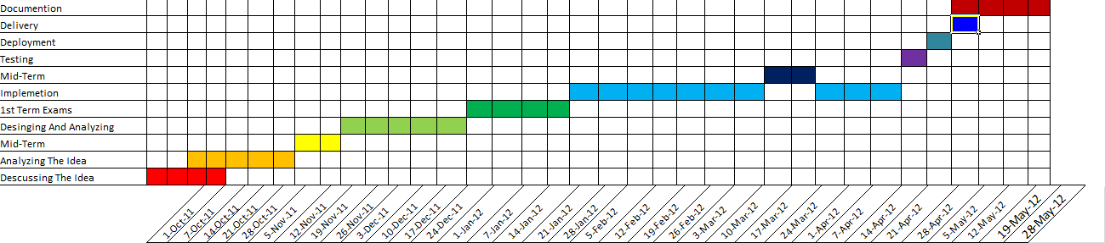
Time Plan

Slide 10


Tools

Slide 11

Questions?

Slide 12


